Slide 1
REALTIME DROWSINESS IDENTIFICATION BASED ON EYE ANALYSIS
PROJECT MEMBERS
GUIDE NAME
Mr.R.Tamilarasu,
Alok C 732119104005
Dheivananth V 732119104014
Ilamugil B S 732119104029
Naveen J 732119104049
ASSOCIATE PROFESSOR,
DEPARTMENT OF COMPUTER SCIENCE
AND ENGINEERING,
NANDHA COLLEGE OF TECHNOLOGY.

Slide 2
ABSTRACT
As per the previous year's report concerning to road crashes indicates that the principal cause of such a fatal road accidents is because of negligence behavior as well as drowsiness of driver.
This problem reveals the requirement of such a system that can recognize drowsiness state of driver and gives alert signal to the driver before the occurrence of any accidents.
Then, it identifies the state of drowsiness, when blink duration becomes more than a certain limits and it produces the alarm, so the driver can wake up and get alert.

Slide 3
INTRODUCTION
As observed, most of the road crashes are caused due the negligence behavior driver when he/she is in state of fall asleep or in drowsy condition while driving the vehicle.
The various techniques that have been employed till date in order to recognize the drowsy state of driver can be mainly categories into three classes such as physiological, behavioral and vehicle parameter based techniques.
This technique uses the visual cues for determining the state of drowsiness of driver.
In our designed framework, detection of drowsy state of driver is primarily based on blinking characteristics of eye using eye aspect ratio parameter.

Slide 4
EXISTING SYSTEM
The various techniques that have been employed till date in order to recognize the drowsy state of driver can be mainly categories into three classes such as physiological, behavioral and vehicle parameter based techniques.
explore the fact that state of drowsiness in driver identified through the various electric signal such as electromyography (EMG) for muscle tone, electroencephalogram (EEG) for brain activity, electrocardiography (ECG) for heart rate, Electro-oculogram (EOG) for ocular activity.

Slide 5
DRAWBACKS OF EXISTING SYSTEM
The Procedures are not performing well in case of micro-sleeps (driver fall asleep on wheel for a moment) because it require bulk amount of data as well as time and effort for measuring these parameters.
Due to this intrusive nature, number of equipments which having the many sensors, have attached on the different portion of driver's body that are capable of learning the brain signals as well nerve impulses and so on.

Slide 6
PROPOSED SYSTEM
The word intrusive means extra equipment that is needed to be attached with the body of driver to fetch the data to identify the state of driver.
So, we have considered the ‘behavioral’ based technique in our proposed work. This technique uses the visual cues for determining the state of drowsiness of driver.
In our designed framework, detection of drowsy state of driver is primarily based on blinking characteristics of eye using eye aspect ratio parameter.
The proposed work, we have adopted the Histogram equalization technique which equally distributes the intensity values throughout the frame as a pre-processing step.

Slide 7
ADVANTAGES OF PROPOSED SYSTEM
In order to resolve the problem shown by physiological a well as vehicle characteristics based drowsiness detection techniques as discussed in above paragraphs, the computer vision techniques came into the existence.
In our proposed work we have developed such a system which can easily be deployable on a machine, robust and reliable to use.
This developed method is highly suitable in comparison of physiological method based system such as EEG, EOG etc.

Slide 8
HARDWARE REQUIREMENTS
Processor | : | Intel i5 2.8GHz
System Ram | : | 4 GB
Hard disk drive | : | 500 GB
Keyboard | : | 106 Multimedia keyboard
Mouse Camera | : : | Optical Mouse 720p Camera or webcamera

Slide 9
SOFTWARE REQUIREMENTS
Language | : | Python
Operating system | : | windows 7/8/8.1/10
Front End | : | Anaconda

Slide 10
LITERATURE SURVEY
Efficient driver drowsiness detection at moderate levels of drowsiness - Forsman, Pia M., et al
EEG alpha spindle measures as indicators of driver fatigue under real traffic conditions - Simon, Michael, et al
The ULg multimodality drowsiness database(called DROZY) and examples of use - Massoz, Quent in, et al
Blink behavior based drowsiness detection – Svensson.U
Real-time system for monitoring driver vigilance - Bergasa, Luis Miguel, et al

Slide 11
Modules
Module 1 : Input Acquisition
Module 2 : Preprocessing
Module 3 : Face Detection
Module 4 : Eye Detection
Module 5 : Eye Aspect Ratio (EAR)
Module 6 : Blink Detection
Module 7 : Alert

Slide 12
Module 1 : Input Acquisition
The input video is taken as a live video from the webcam, which are having the properties that are in the RGB.
The person who wanted to drive is placing their eye on the web camera, which are been used to detect the better resolution.
In the input acquisition, the input video is been extracted from the web camera for the detection of the iris in such a way that there is seen that the person’s eye is open in this case the detection process are been extracted for the drowsy driver detection.

Slide 13
Module 2 : Preprocessing
Preprocessing is a common step that is been used to extract the accurate video from the noisy format.
There are highlighting some features, which are used to enhance the image for the preprocessing step.
The captured video are having the non uniform form of the retina image that is illuminating to correct the unwanted noise in the image which is caused by the in-accurate fixing of the eye in the acceptable location.

Slide 14
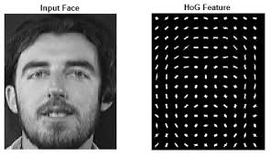
Module 3 : Face Detection
In our designed framework, we have considered the facial feature tracker library to detect the face from image of driver.
Since libraries based on Histogram of Oriented Gradient (HOG) feature descriptor for face detection.
Here, in simple words, The gradient is a sudden change in pixel value when we step from left to right or top to bottom i. e. from black to white or vice-versa.

Slide 15
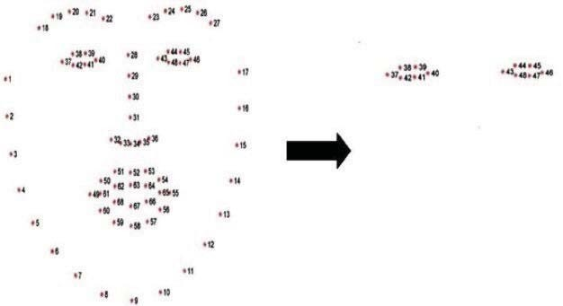
Module 4:Eye Detection
The different feature related to face gives the obvious sign of a drowsy state.
Among these features,The blinking of eyes is the prominent one to decide the state of drowsiness as per the various studies discussed above.
Since, in our designed framework, we have imported the facial shape predictor packages to eliminate the inbuilt landmarks for both the eyes from the available landmarks.

Slide 16
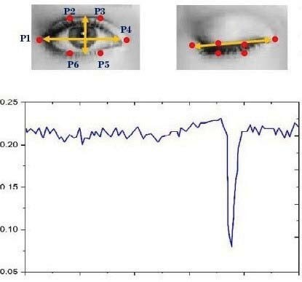
Module 5:Eye Aspect Ratio (EAR)
Eye aspect ratio (EAR) was estimated from the spot of the selected landmarks coordinate.
Contiguous landmarks of the package are necessary to localize each eye i.e. either the left or right eye.
These landmarks play a key role in the computation of eye aspect ratio.

Slide 17
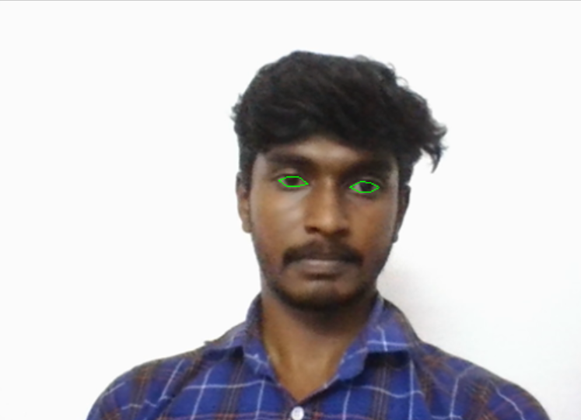
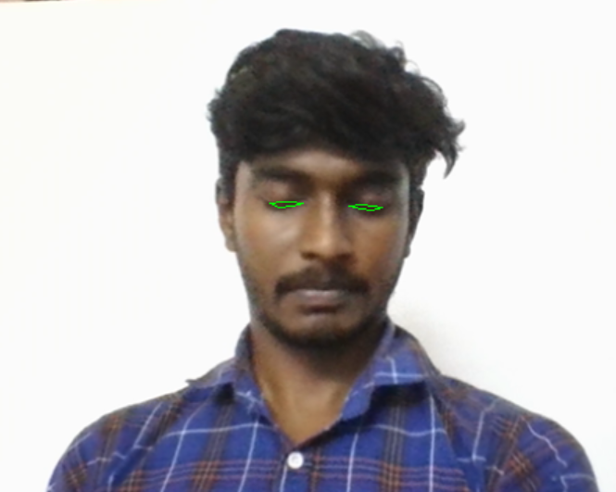
Module 6 : Blink Detection
From the experiment, we have considered a threshold for EAR in order to establish the distinction between the open as well as close state of eye.
Here,The Time elapsed during the closing state of the eye is assumed as T. The different state of driver on the basis of EAR value and elapsed.
Therefore,The Time elapsed during eye closing can also be considered in terms of the number of frames.

Slide 18
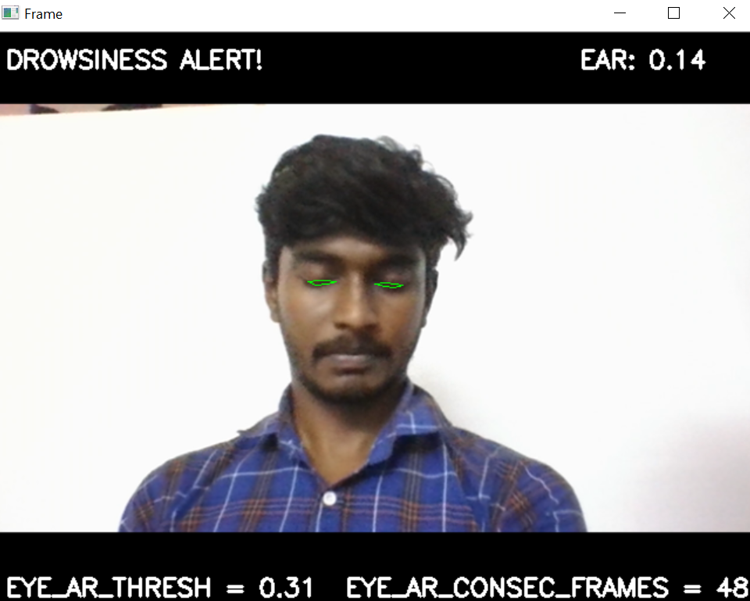
Module 7 :Alert
In the final module, we develop the Drowsiness alert according to the Eye Analysis Ration (EAR), so the driver gets the Alert sound and so the driver can know that he/she is in the sleepy stage and take necessary action accordingly, which prevents the accident.

Slide 19
CONCLUSION
This project proposes a drowsiness detection system based on driver behavior.
The role of the system is to detect facial landmarks from the live webcam that are collected while the person is driving the vehicle by a camera module attached to the vehicle and deliver the obtained data to the trained model to identify the driver's state and provide an alert if the driver feels drowsy.
In our proposed work we have developed such a system which can easily be deployable on a machine, robust and reliable to use.
Because it is intrusive means there is no need to attach any extra equipment to the body of the driver to detect the state of drowsiness.

Slide 20
FUTURE ENHANCEMENT
Although, our developed framework gives a better result in recognizing driver's state of drowsiness.
Yet, some issues still remain which badly affect the performance of our designed system like our system will not give the prominence result under the low visibility condition or during night hour.
In future, we would like to use some robust software like a CNN-face detector which could identify the face clearly when head movement is extremely in any direction but we will have to keep attention to settle the time elapsed in recognition of drowsiness.
Since, we have faced the problem to set threshold value of EAR due to the different dimension of the eyes of participant.
Therefore, one can normalize the data at this stage to suite this problem in future and enhance the accuracy of overall system

Slide 21
REFERENCES
“Road Accidents in India 2018”. Available: https://morth.nic.in/sites/default/files/Road_Accidednt.pdf, pp. 1-125
Massoz, Quent in, et al. "The ULg multimodality drowsiness database (called DROZY) and examples of use." 2016 IEEE Winter Conference on Applications of Computer Vision (WACV). IEEE, 2016.
Kazemi, Vahid, and Josephine Sullivan. "One millisecond face alignment with an ensemble of regression trees." Proceedings of the IEEE conference on computer vision and pat tern recognition. 2014.
Forsman, Pia M., et al. "Efficient driver drowsiness detection at moderate levels of drowsiness." Accident Analysis & Prevent ion 50 (2013): 341-350.
Zhihong, Wu, and Xiao Xiaohong. "Study on histogram equalization." Intelligence Information Processing and Trusted Comput ing, International Symposium on. IEEE Computer Society, 2011.

